Slide 1
8
VECTORS AND THE
GEOMETRY OF SPACE
Copyright © Cengage Learning. All rights reserved.

Slide 2
8.2
Vectors
Copyright © Cengage Learning. All rights reserved.

Slide 3

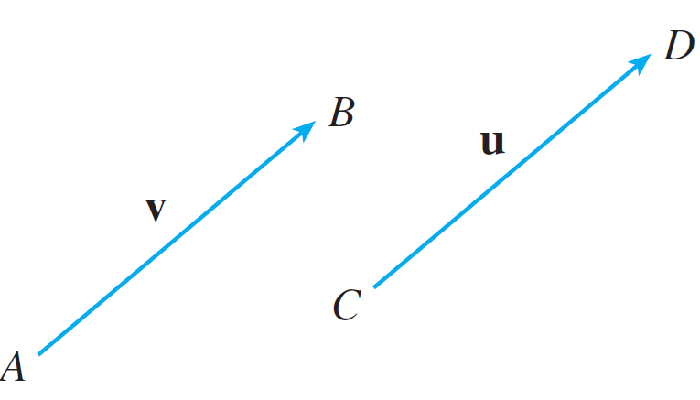
Vectors
Suppose a particle moves along a line segment from point A to point B. The corresponding displacement vector v, shown in Figure 1, has initial point A (the tail) and terminal point B (the tip) and we indicate this by writing
v =
Equivalent vectors
Figure 1

Slide 4

Vectors
The term vector is used by scientists to indicate a quantity (such as displacement or velocity or force) that has both magnitude and direction.
A vector is often represented by an arrow or a directed line segment. The length of the arrow represents the magnitude of the vector and the arrow points in the direction of the vector.
We denote a vector by printing a letter in boldface (v) or by putting an arrow above the letter

Slide 5

Vectors
Notice that the vector u = has the same length and the same direction as v even though it is in a different position.
We say that u and v are equivalent (or equal) and we write u = v. The zero vector, denoted by 0, has length 0. It
is the only vector with no specific direction.

Slide 6
Combining Vectors

Slide 7


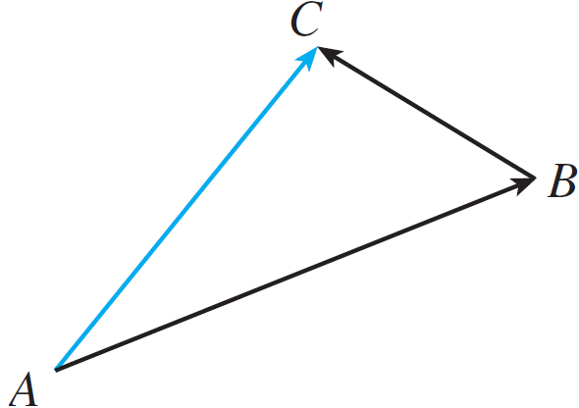
Combining Vectors
Suppose a particle moves from A to B, so its displacement vector is Then the particle changes direction and moves from B to C, with displacement vector as in Figure 2.
The combined effect of these displacements is that the particle has moved from A to C.
Figure 2

Slide 8


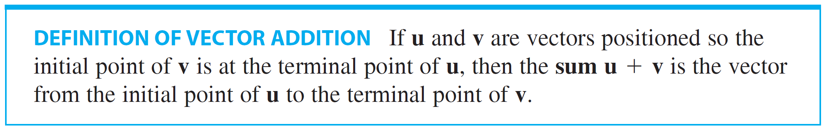
Combining Vectors
The resulting displacement vector is called the sum of
and and we write
In general, if we start with vectors u and v, we first move v so that its tail coincides with the tip of u and define the sum of u and v as follows.

Slide 9
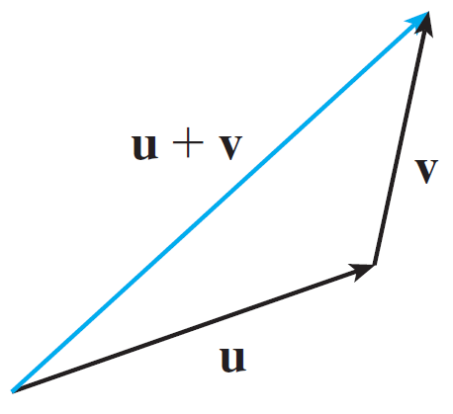
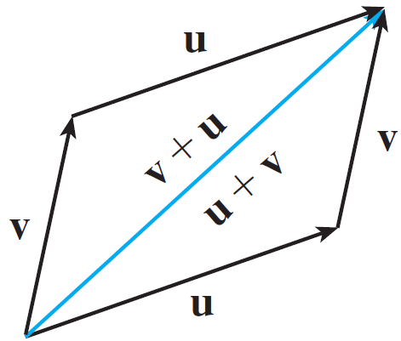
Combining Vectors
The definition of vector addition is illustrated in Figure 3. You can see why this definition is sometimes called the Triangle Law.
In Figure 4 we start with the same vectors u and v as in Figure 3 and draw another copy of v with the same initial point as u.
The Triangle Law
The Parallelogram Law
Figure 3
Figure 4

Slide 10
Combining Vectors
Completing the parallelogram, we see that u + v = v + u.
This also gives another way to construct the sum: If we place u and v so they start at the same point, then u + v lies along the diagonal of the parallelogram with u and v as sides. (This is called the Parallelogram Law.)

Slide 11
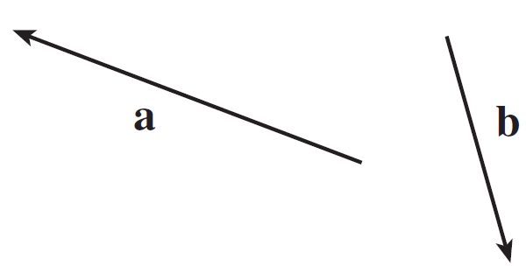
Example 1
Draw the sum of the vectors a and b shown in Figure 5.
Solution:
First we translate b and place its tail at the tip of a, being careful to draw a copy of b that has the same length and
direction.
Figure 5

Slide 12
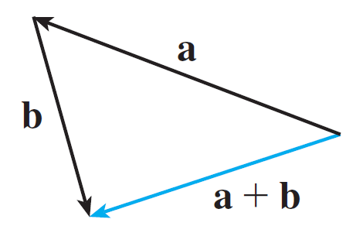
Example 1 – Solution
cont’d
Then we draw the vector a + b [see Figure 6(a)] starting at the initial point of a and ending at the terminal point of the copy of b.
Figure 6(a)

Slide 13
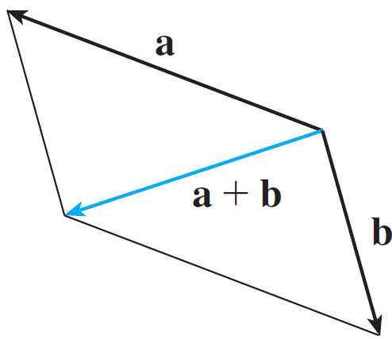
Example 1 – Solution
cont’d
Alternatively, we could place b so it starts where a starts and construct a + b by the Parallelogram Law as in
Figure 6(b).
Figure 6(b)

Slide 14
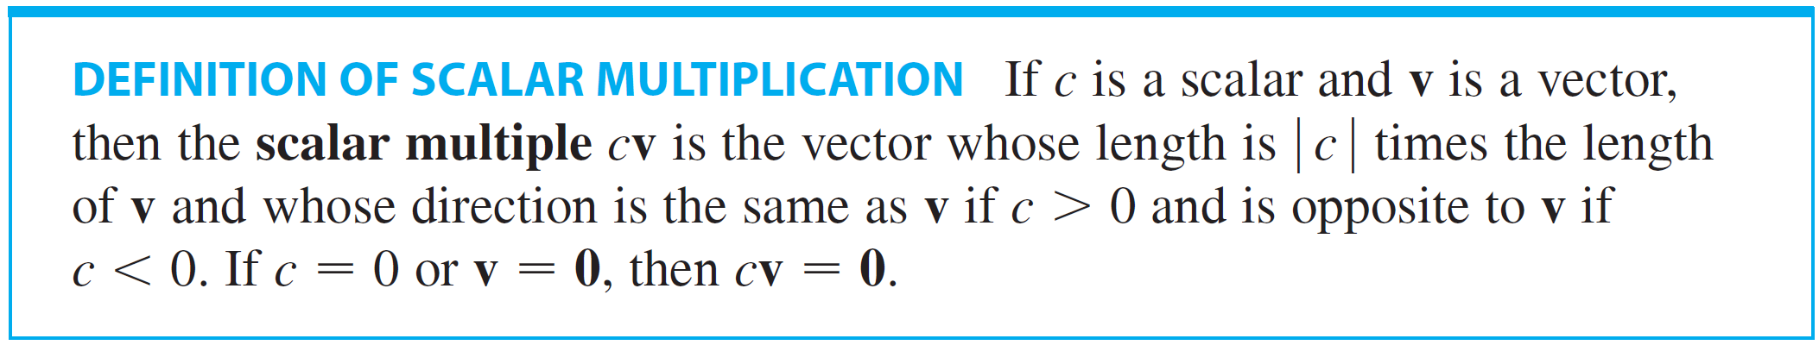
Combining Vectors
It is possible to multiply a vector by a real number c. (In this context we call the real number c a scalar to distinguish it from a vector.) For instance, we want 2v to be the same vector as v + v, which has the same direction as v but is twice as long. In general, we multiply a vector by a scalar as follows.

Slide 15
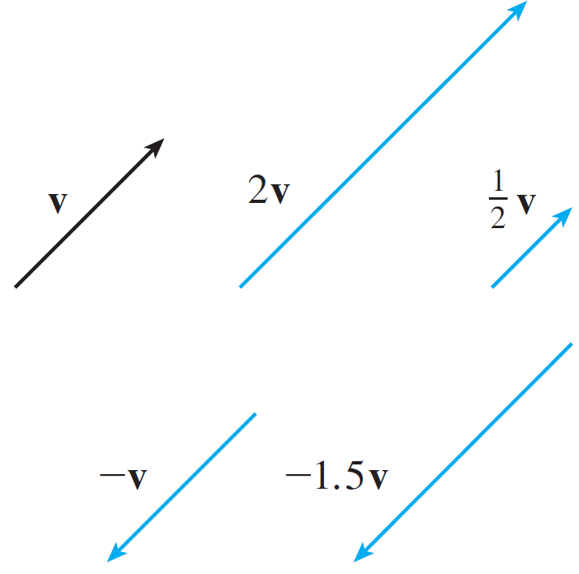
Combining Vectors
This definition is illustrated in Figure 7. We see that real numbers work like scaling factors here; that’s why we call them scalars.
Notice that two nonzero
vectors are parallel if they are
scalar multiples of one another.
In particular, the vector –v = (–1)v
has the same length as v but points
in the opposite direction. We call it
the negative of v.
Scalar multiples of v
Figure 7

Slide 16
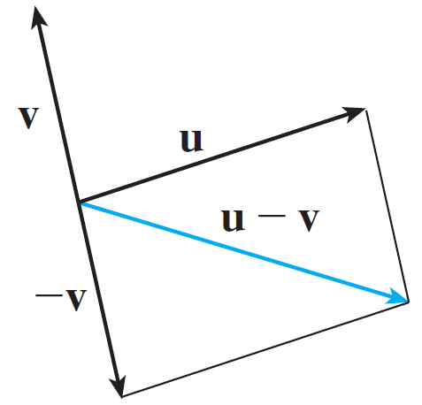
Combining Vectors
By the difference u – v of two vectors we mean
u – v = u + (–v)
So we can construct u – v by first drawing the negative of v, –v, and then adding it to u by the Parallelogram Law as in Figure 8(a).
Drawing u – v
Figure 8(a)

Slide 17
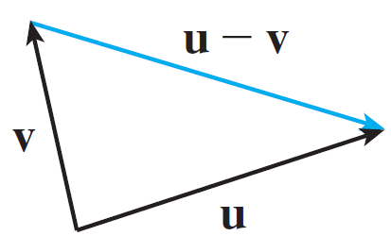
Combining Vectors
Alternatively, since v + (u – v) = u, the vector u – v, when added to v, gives u. So we could construct u – v as in Figure 8(b) by means of the Triangle Law.
Drawing u – v
Figure 8(b)

Slide 18
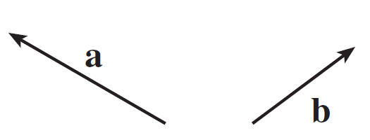
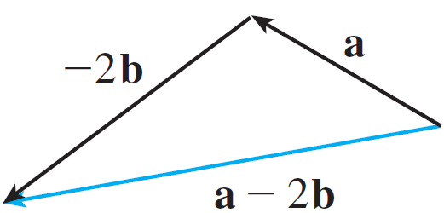
Example 2
If a and b are the vectors shown in Figure 9, draw a – 2b.
Solution:
We first draw the vector –2b pointing in
the direction opposite to b and twice as
long. We place it with its tail at the tip of
a and then use the Triangle Law to draw
a + (–2b) as in Figure 10.
Figure 9
Figure 10

Slide 19
Components

Slide 20
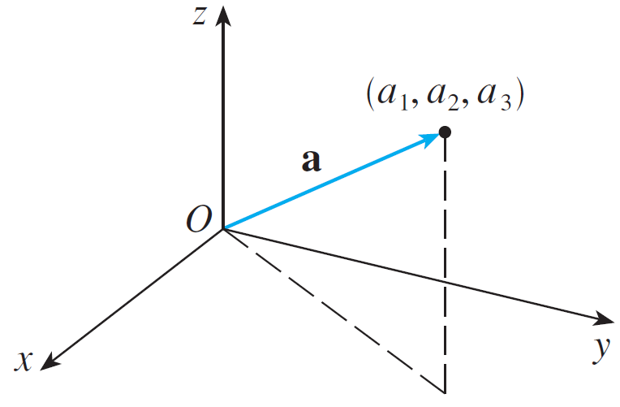
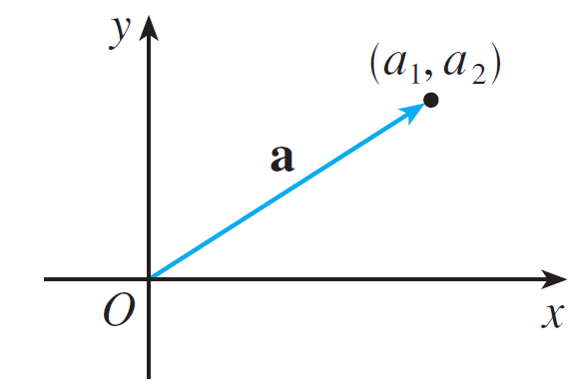
Components
We introduce a coordinate system and treat vectors algebraically.
a = ⟨a₁, a₂⟩
a = ⟨a₁, a₂, a₃⟩
Figure 11

Slide 21
Components
These coordinates are called the components of a and we write
a = ⟨a₁, a₂⟩ or a = ⟨a₁, a₂, a₃⟩
We use the notation ⟨a₁, a₂⟩ for the ordered pair that refers to a vector so as not to confuse it with the ordered pair
(a₁, a₂) that refers to a point in the plane.

Slide 22

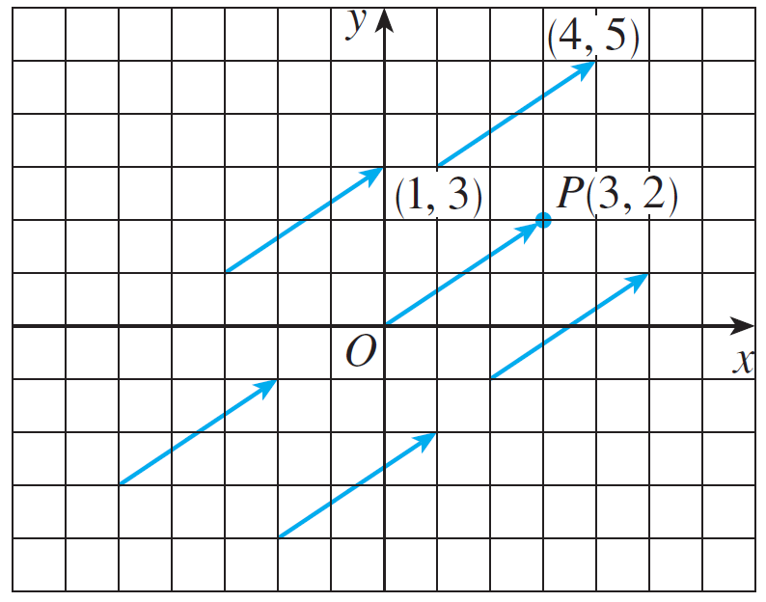

Components
For instance, the vectors shown in Figure 12 are all equivalent to the vector whose terminal point is P(3, 2).
We can think of all these geometric vectors as representations of the algebraic vector a = ⟨3, 2⟩.
: position vector of the point P
Representations of the vector a = ⟨3, 2⟩
Figure 12

Slide 23


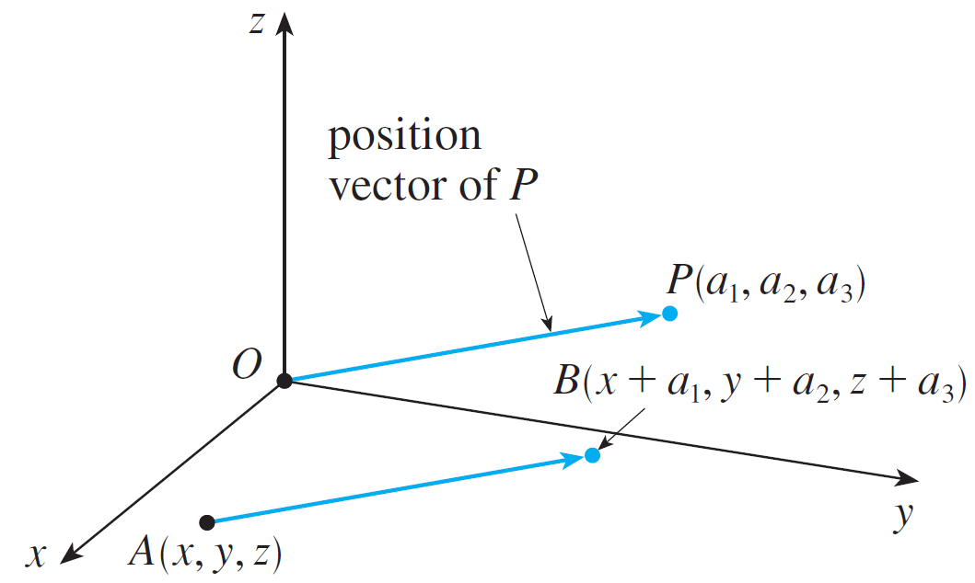
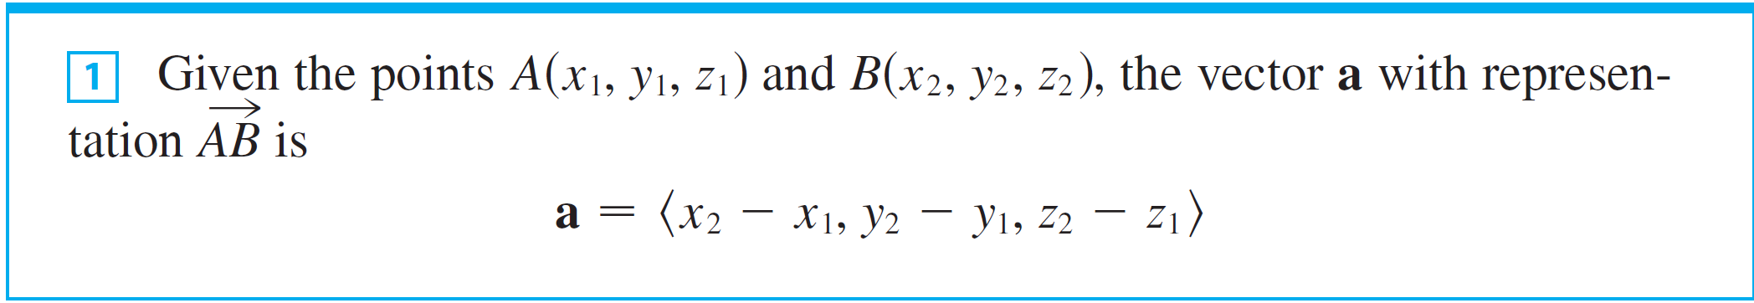
Components
In three dimensions, the vector is the position vector of the P(a₁, a₂, a₃). (See Figure 13.) Let’s consider any other representation of a, where the initial point is A(x₁, y₁, z₁) and the terminal point is B(x₂, y₂, z₂).
Representations of a = ⟨a₁, a₂, a₃⟩
Figure 13

Slide 24


Example 3
Find the vector represented by the directed line segment with initial point A(2, –3, 4) and terminal point B(–2, 1, 1).
Solution:
By , the vector corresponding to is

Slide 25
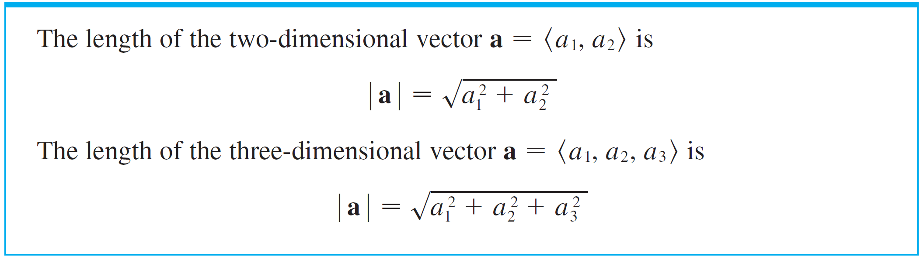
Components
The magnitude or length of the vector v is the length of any of its representations and is denoted by the symbol
|v| or ||v||. By using the distance formula to compute the length of a segment OP, we obtain the following formulas.

Slide 26


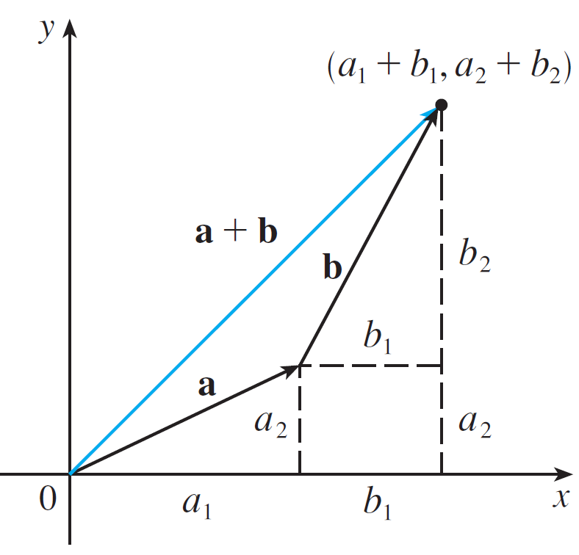
Components
How do we add vectors algebraically? Figure 14 shows that if and then the sum is
at least for the case where the components are positive.
Figure 14

Slide 27
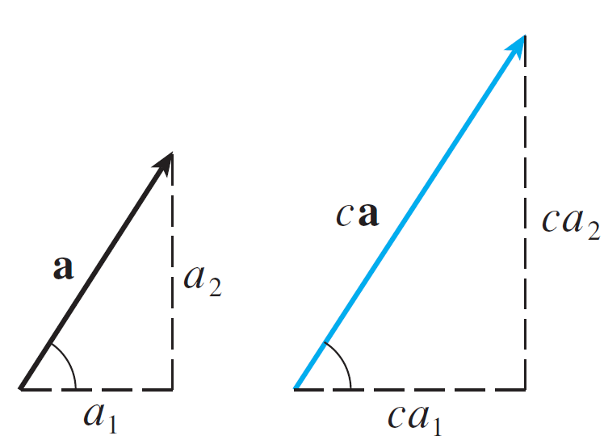
Components
In other words, to add algebraic vectors we add their components. Similarly, to subtract vectors we subtract components. From the similar triangles in Figure 15 we see that the components of ca are ca₁ and ca₂. So to multiply a vector by a scalar we multiply each component by that scalar.
Figure 15

Slide 28
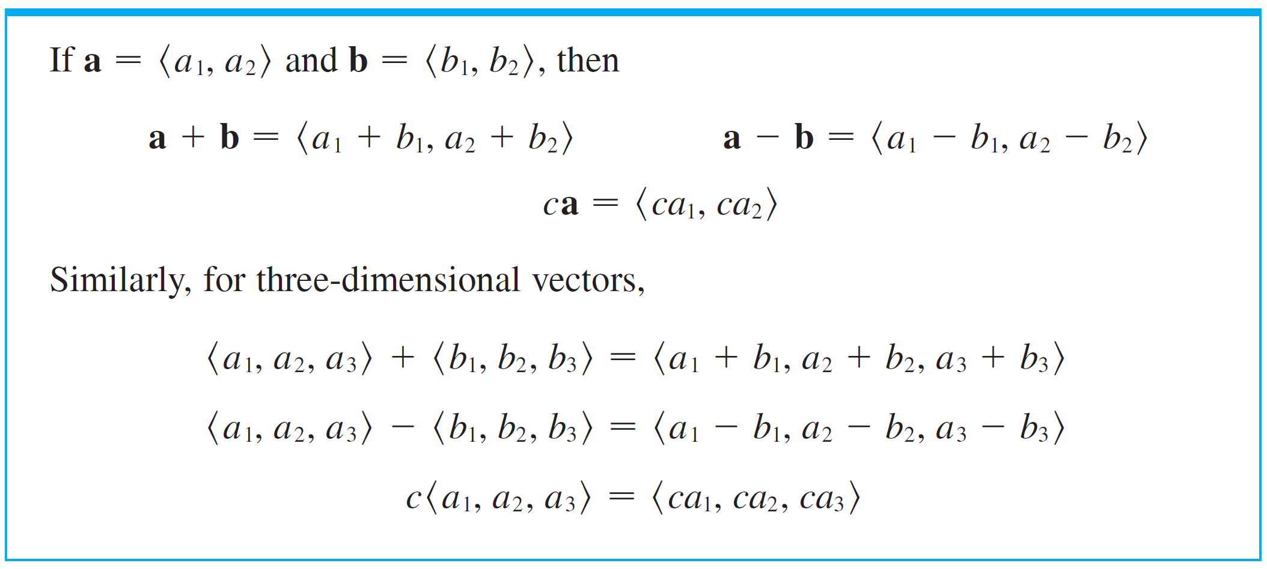
Components

Slide 29
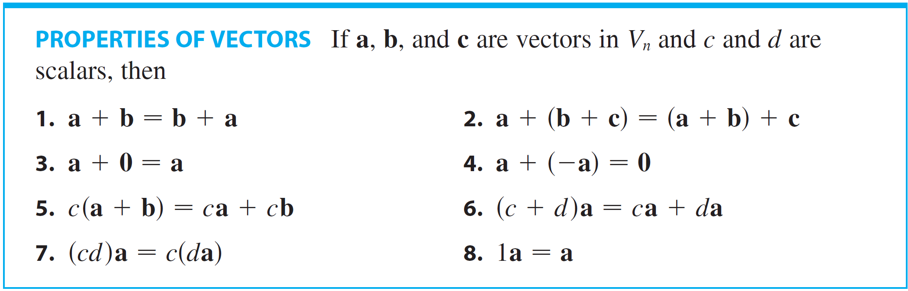

Components
Three vectors in V₃ play a special role. Let

Slide 30

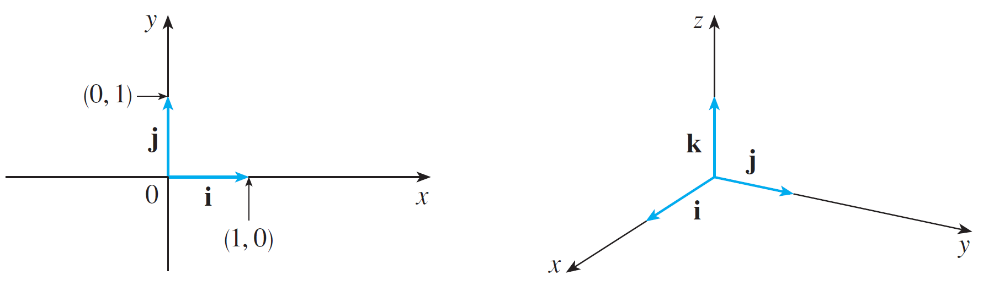
Components
These vectors i, j, and k are called the standard basis vectors. They have length 1 and point in the directions of the positive x-, y-, and z-axes. Similarly, in two dimensions we define and (See Figure 17.)
(a)
(b)
Standard basis vectors in V₂ and V₃
Figure 17

Slide 31





Components
If , then we can write
Similarly, in two dimensions, we can write

Slide 32
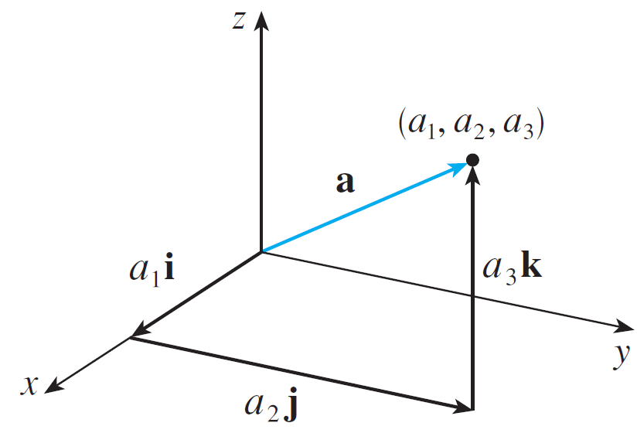
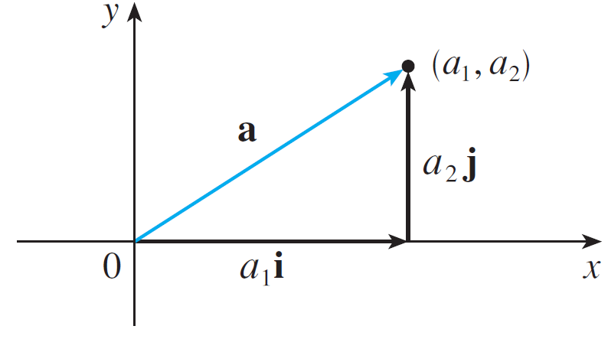
Components
See Figure 18 for the geometric interpretation of Equations 3 and 2 and compare with Figure 17.
(a) a = a₁i + a₂ j
(b) a = a₁i + a₂ j + a₃k
Figure 18

Slide 33
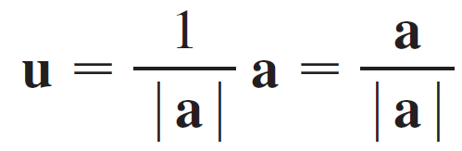

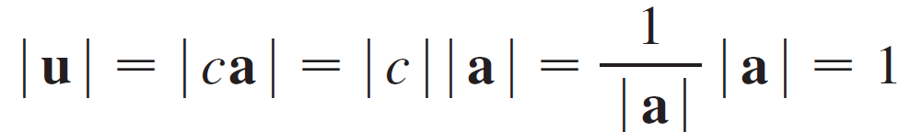
Components
A unit vector is a vector whose length is 1. For instance,
i, j, and k are all unit vectors. In general, if a ≠ 0, then the unit vector that has the same direction as a is
In order to verify this we let c = 1/| a |. Then u = ca and c is a positive scalar, so u has the same direction as a. Also

